Slide 1

Mini project Presentation SESSION 2021-22
Department of Information Technology
ABES Engineering College, Ghaziabad,UP
Team Name :GODAM MEMBERS
Class & Section :IT A 3rd year
Member Name :Ansh Bhardwaj 1900320130027
:Akshit Kumar Tyagi 1900320130015
:Akash Verma 1900320130011

Slide 2
E-Godam
VISION To promote uniformity in agriculture marketing by streamlining of procedures across the integrated markets, removing information asymmetry between buyers and sellers and promoting real time price discovery based on actual demand and supply.
MISSION
Integration of APMCs across the country through a common online market platform to facilitate pan-India trade in agriculture commodities, providing better price discovery through transparent auction process based on quality of produce along with timely online payment.

Slide 3
Project description
E-Godam is an online trading platform for agricultural commodities in India. The market facilitates farmers, traders and buyers with online trading in commodities.
Various facilites given to stake holders-
Farmers: They can sell products without the interference of any brokers or middlemen thereby making competitive returns out of their investment.
Traders: Traders will be able to do secondary trading from one APMC to another one anywhere in India. Local traders can get access to the larger national market for secondary trading.
Buyers: Processers & Exporters

Slide 4
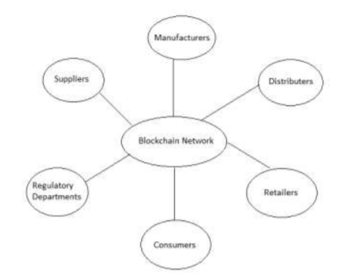
Project flow

Slide 5
Technology used
Bootstrap 4
HTML,CSS,JAVASRIPT
php

Slide 6
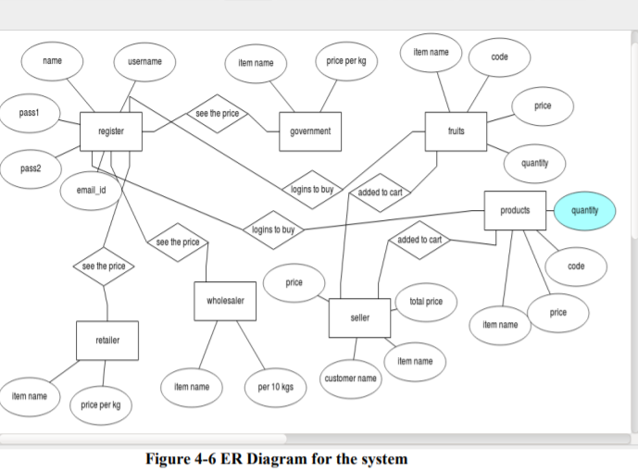
Er diagram

Slide 7
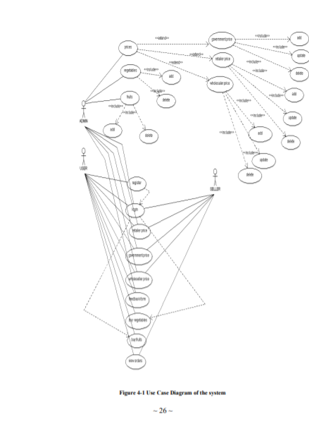
USE case diagram

Slide 8
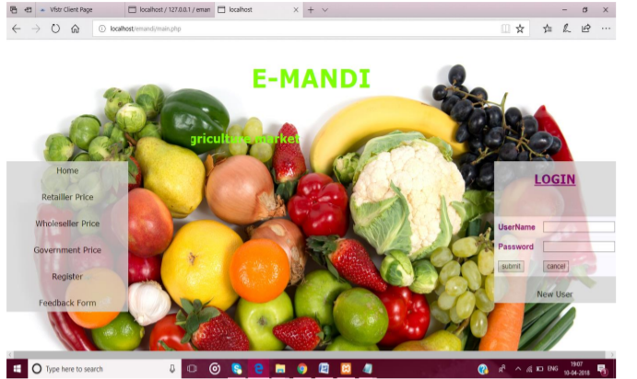
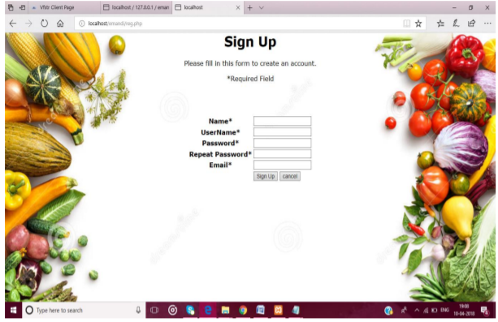
Screens

Slide 9
